Slide 1

LASSO P20151 “hail Mary test”
Results from the LUSAT pass over Shrewsbury and Fairport on March 26th at 2:30pm

Slide 2
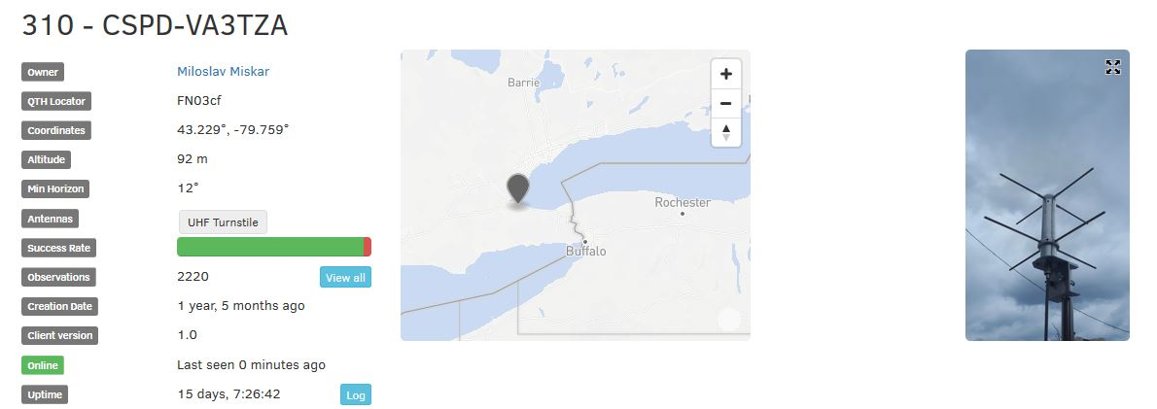
LUSAT Test
In order to improve on satellite signal reception, a receiver test was carried out that was a “piggyback” of a planned observation on SATNOGS.
Notes:
Andrew

Slide 3
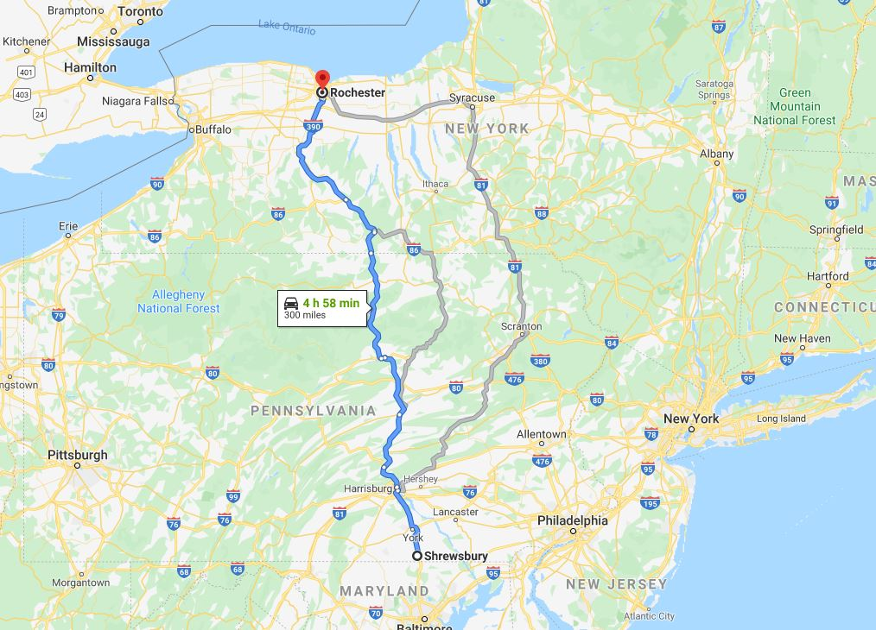
Stations
Pi1 at Luca’s house in ROC
Pi2 at Anthony’s house in PA
The stations were synched
using gps receivers
Notes:
Andrew

Slide 4
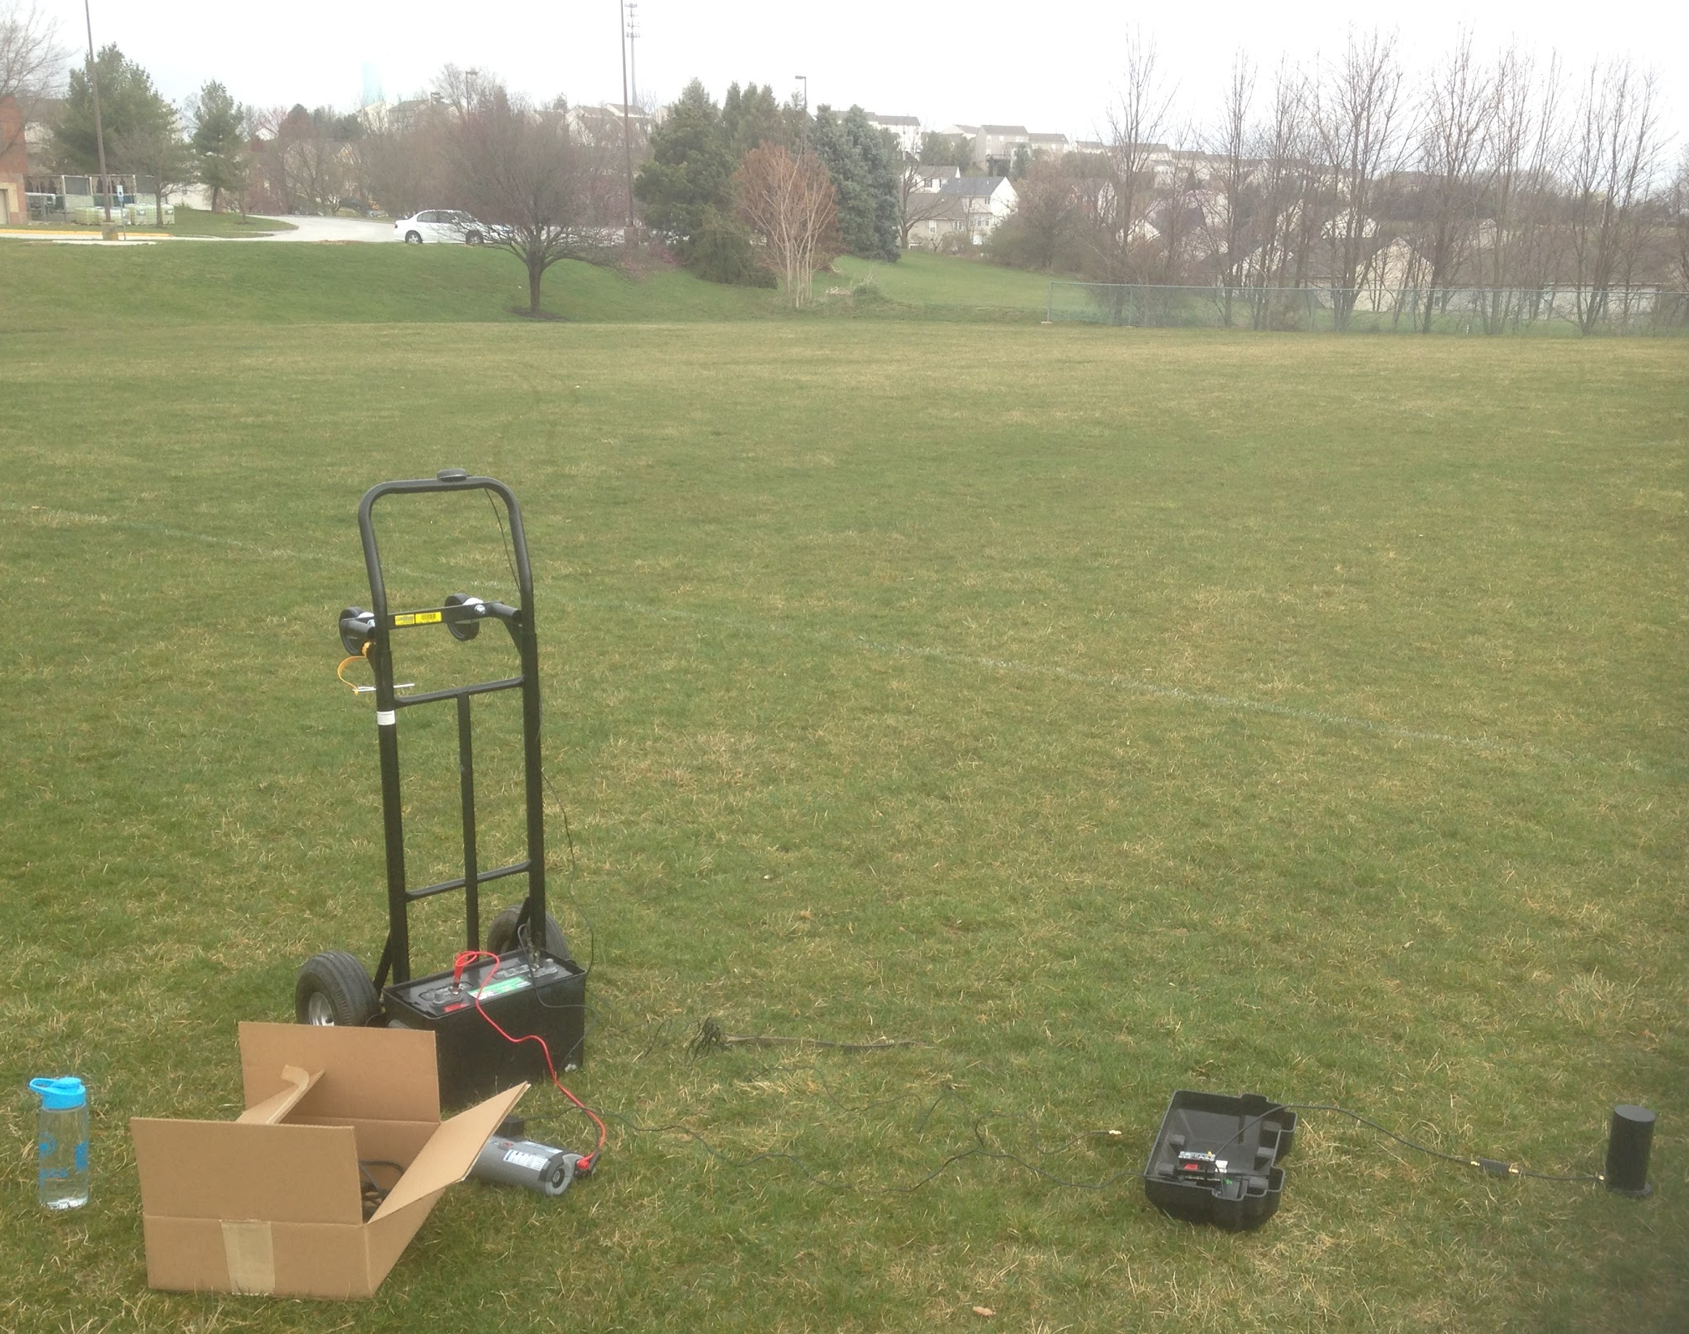
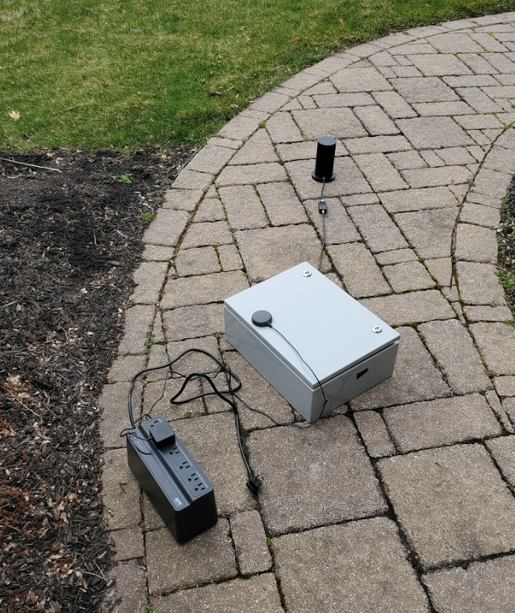
300 mile cross-correlation.
Luca’s yard, Fairport NY
The local Elementary school, Shrewsbury PA
Antenna
LNA
GPS
GPS
Antenna
Inside of our box
Battery
Battery
LNA
Notes:
Anthony

Slide 5
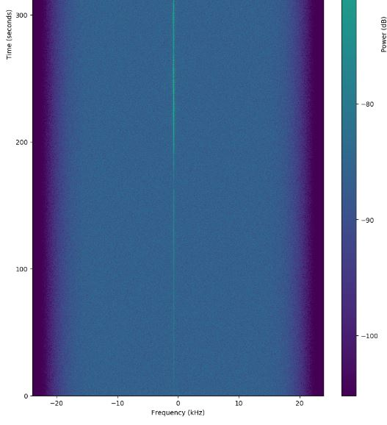
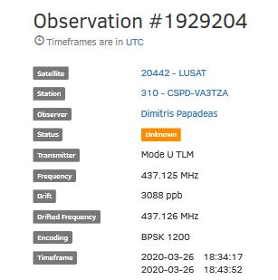
Satnogs Results
Notes:
Andrew

Slide 6
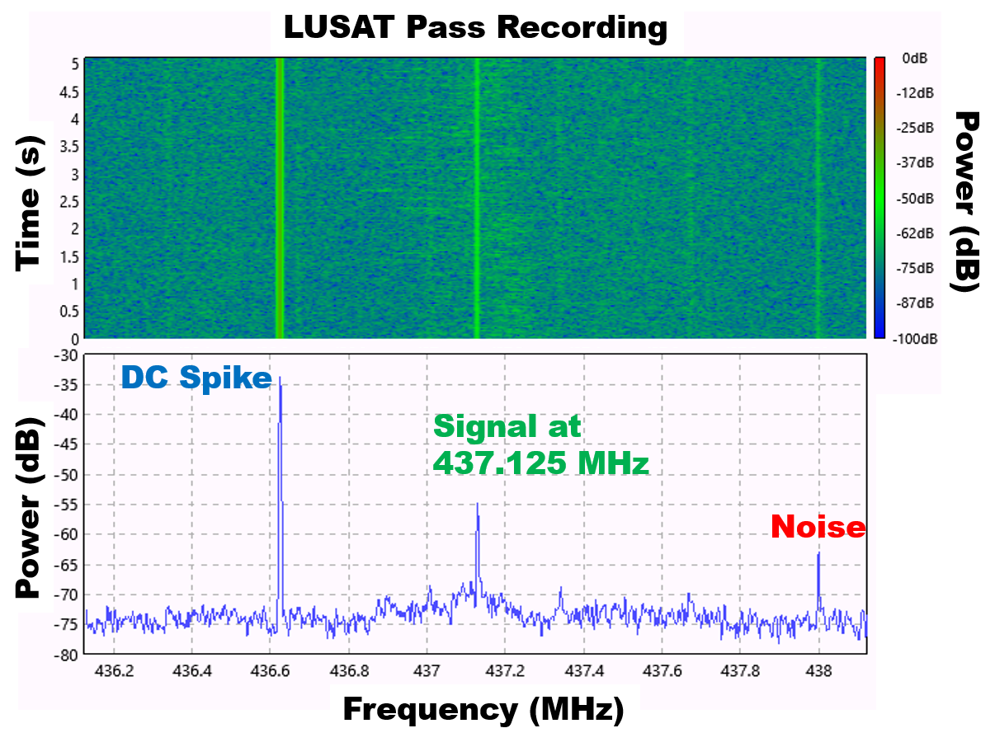

LASSO Rendered Result at Pi 1
Play audio. Listen for the high pitch whistle. The change in tones is due to doppler shift.

Slide 7
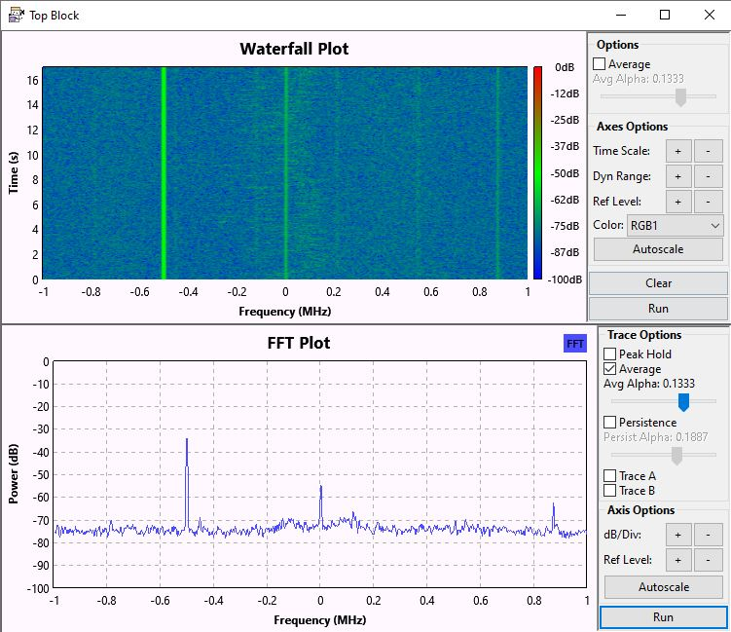
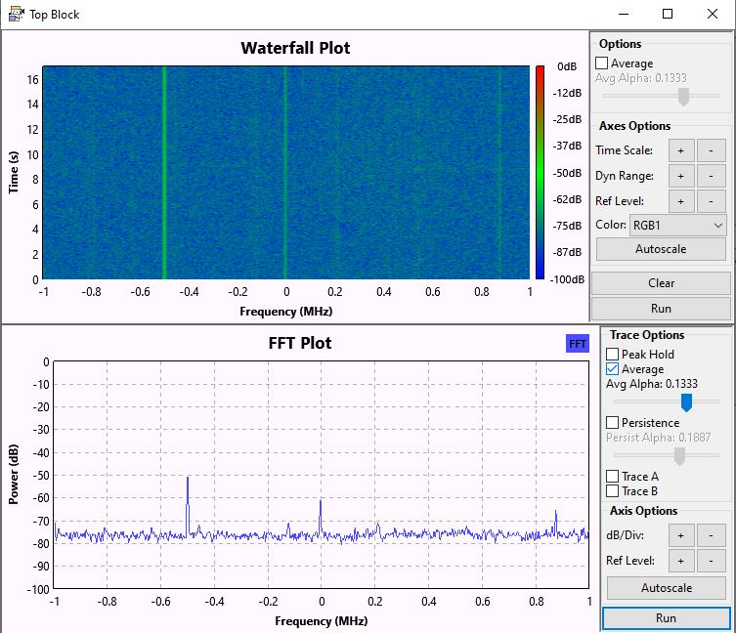
Lasso Results - Channel Frequency at 437.125 MHz
DC Spike
Signal at 437.125 MHz
DC Spike
Signal at 437.125 MHz
Noise
Noise
Pi 1 2020-03-26_18_38_39_100000
Pi 2
Notes:
Andrew

Slide 8
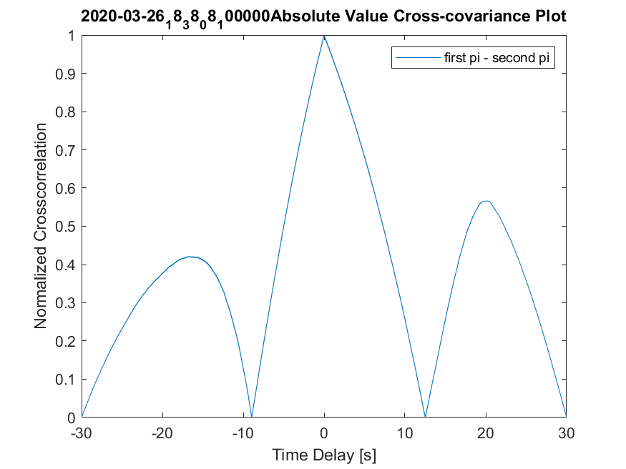
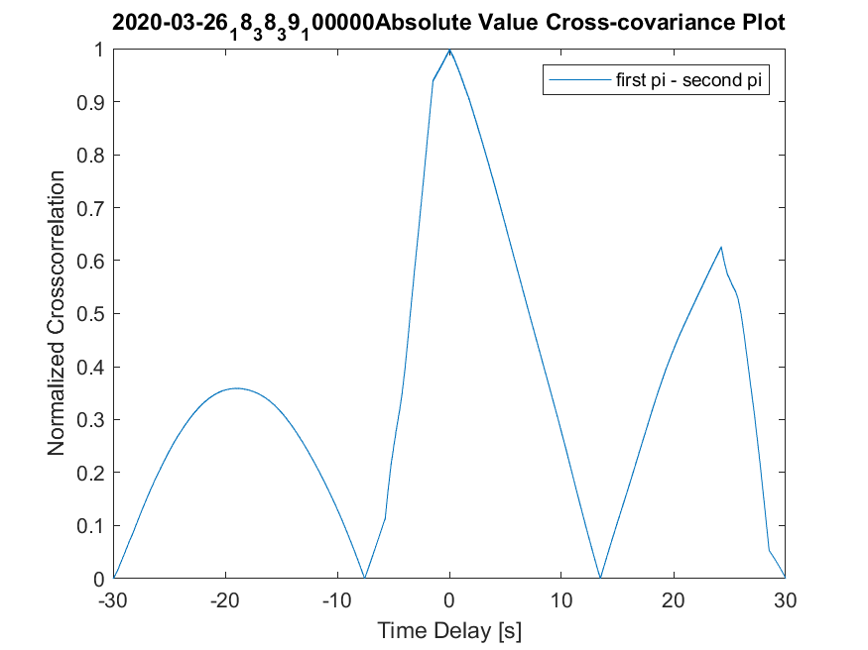
Cross Correlation Results
30 second recordings were captured over the duration of the pass. Below are best two cross-correlation plots.
Notes:
Andrew

Slide 9
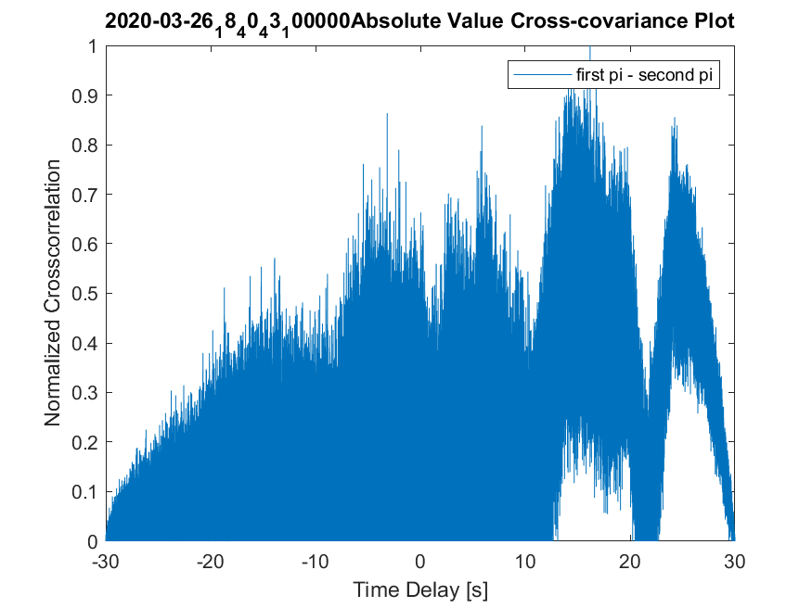
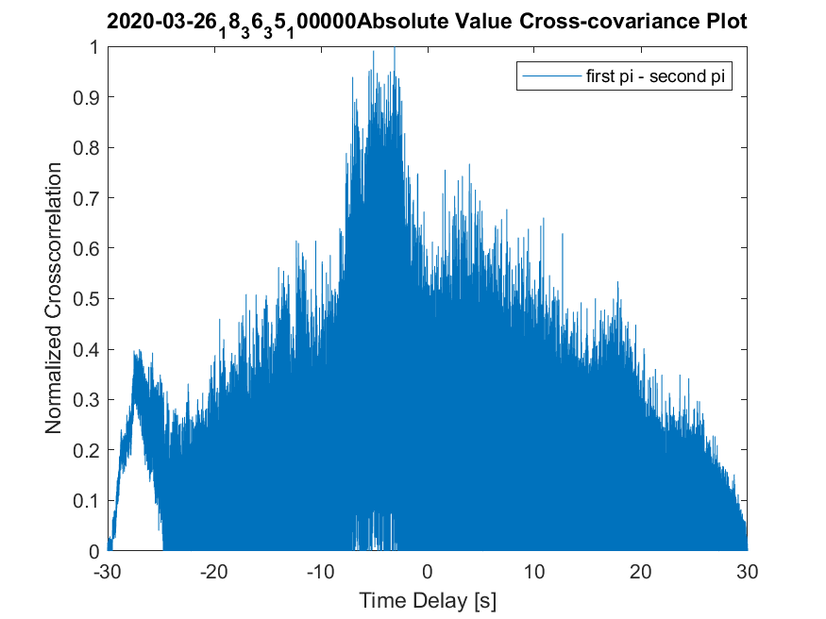
Cross Correlation Results
30 second recordings were captured over the duration of the pass. Below are examples of worse cross-correlation plots.
Notes:
Andrew

Slide 10
Estimating the Satellite Position Correct Answer
TLE to use for pass:
LUSAT (LO-19)
1 20442U 90005G 20086.83847551 .00000012 00000-0 20663-4 0 9997
2 20442 98.6840 33.8464 0012561 42.2785 317.9365 14.32948068576726
Used LASSO Orekit Code with the following inputs:
noradID=20442
channelFrequency=437.15
initialTime=2020-03-26T18:00:00.000:+00:00
endTime=2020-03-26T18:55:00.000:+00:00
errorTimeForTLE=0
recordingRate=0.1
paddingTime=0
From the AzEl.txt it generates, we get the absolute times, relative times, and position information (elevation, azimuth, and range with respect to each station).

Slide 11
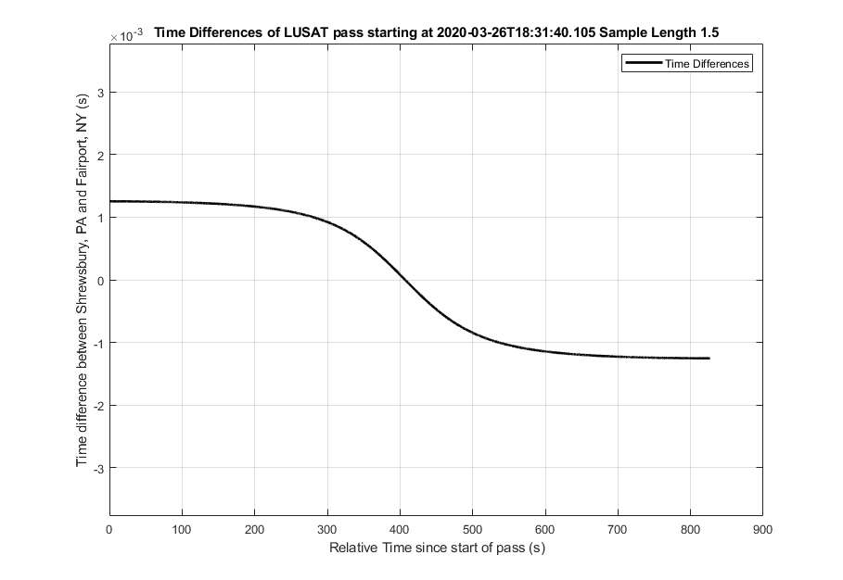
Estimating the Satellite expected Time_delays
Given the location of the 2 stations and the position of the satellite at a specific instance (1 row in the ElAz.txt file):
Calculate an absolute distance between satellite and each station.
Subtract these values and divide by the speed of light.
The Result is a continuous time difference throughout the pass.

Slide 12
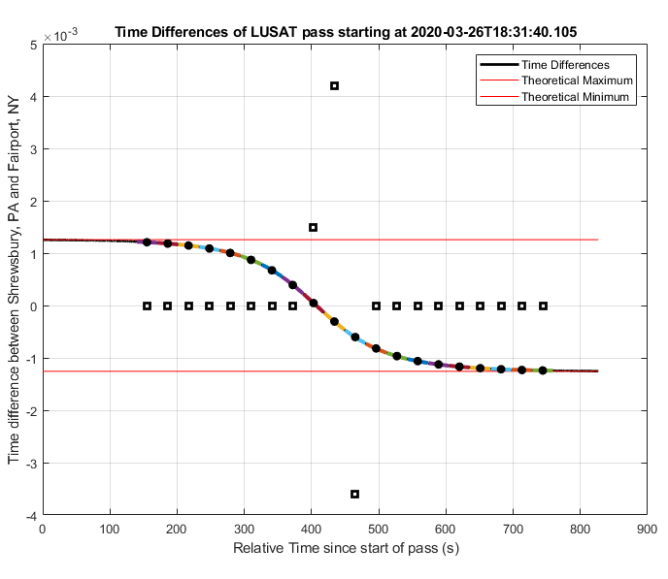
Estimating the Satellite expected Time_delays
The Result is a continuous time difference throughout the pass.
Our cross-correlations estimate a time delay over a discrete amount of time.
It essentially calculates an “average” time difference, thus we need to discretize our correct answer signal based on the length of cross-correlation.
One 30 second window.
Avg. Time_delay based on correct answer.

Slide 13
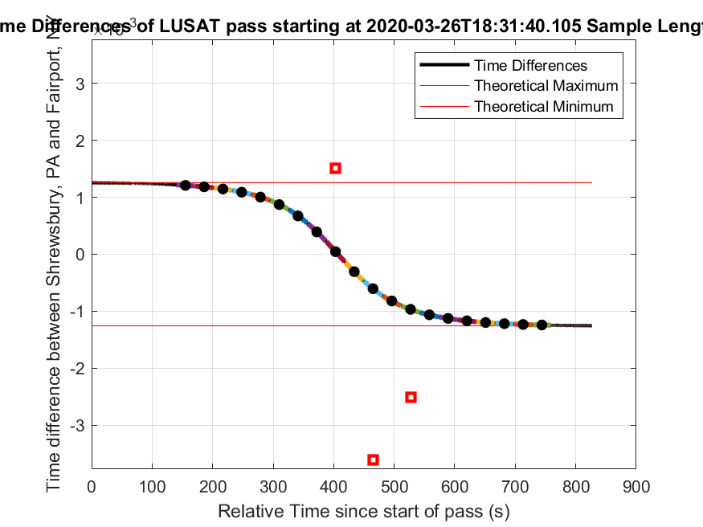
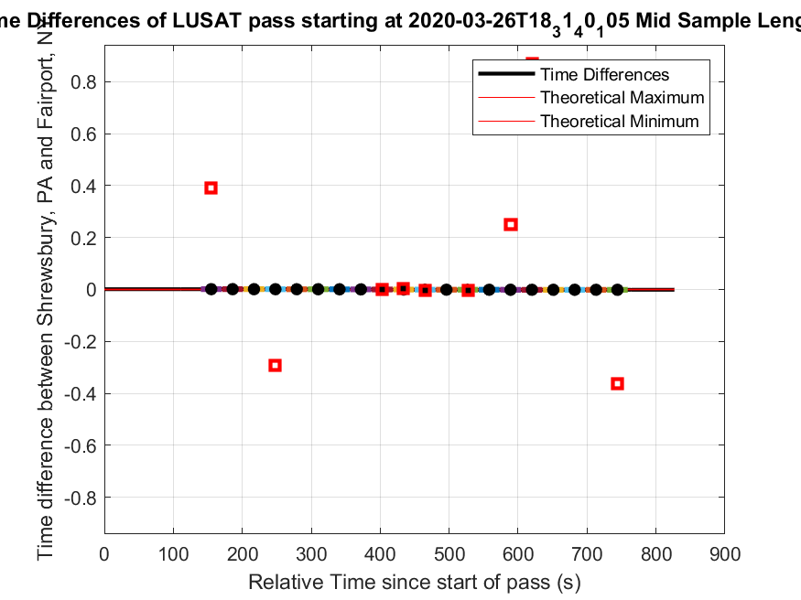
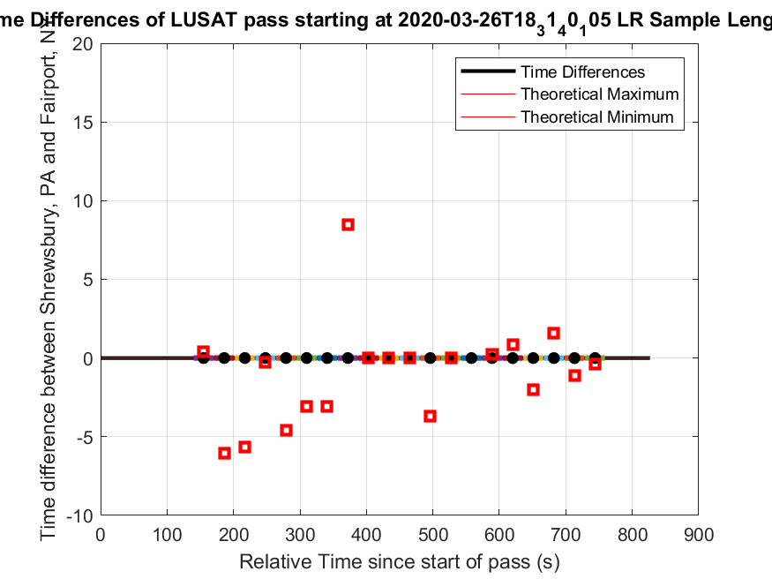
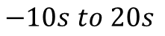
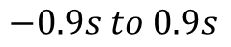
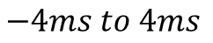
Results Using 30 second time intervals.
The below plots are all the same dataset, but have different y scales.
Only 3 of the time differences are remotely close to the correct answer!
The satellite moves ~240 km in a 30 second time interval with speeds of 8 km/s. It is understandable these are wrong.
$$−4ms to 4ms$$
$$−0.9s to 0.9s$$
$$−10s to 20s$$

Slide 14
Results Using 30 second time intervals.
Scheduled Date | CC values (ms) | Ground Truth (ms) | Difference (ms)
2020-03-26T18:34:00.100000 | 389.4595 | 1.208289972 | 388.2512
2020-03-26T18:34:31.100000 | -6021.609 | 1.182722797 | -6022.79
2020-03-26T18:35:02.100000 | -5663.7365 | 1.145015917 | -5664.88
2020-03-26T18:35:33.100000 | -291.546 | 1.088590832 | -292.635
2020-03-26T18:36:04.100000 | -4604.9225 | 1.002728585 | -4605.93
2020-03-26T18:36:35.100000 | -3095.325 | 0.870899793 | -3096.2
2020-03-26T18:37:06.100000 | -3076.7435 | 0.671954753 | -3077.42
2020-03-26T18:37:37.100000 | 8503.7995 | 0.391608911 | 8503.408
2020-03-26T18:38:08.100000 | 1.506 | 0.046618476 | 1.459382
2020-03-26T18:38:39.100000 | 4.19 | -0.305756882 | 4.495757
2020-03-26T18:39:10.100000 | -3.6135 | -0.603142027 | -3.01036
2020-03-26T18:39:41.100000 | -3673.769 | -0.81990706 | -3672.95
2020-03-26T18:40:12.100000 | -2.504 | -0.965789237 | -1.53821
2020-03-26T18:40:43.100000 | 16181.713 | -1.061621735 | 16182.77
2020-03-26T18:41:14.100000 | 251.552 | -1.124995526 | 252.677
2020-03-26T18:41:45.100000 | 869.962 | -1.167652518 | 871.1297
2020-03-26T18:42:16.100000 | -1992.226 | -1.196876586 | -1991.03
2020-03-26T18:42:47.100000 | 1605.24 | -1.217136759 | 1606.457
2020-03-26T18:43:18.100000 | -1121.133 | -1.231215901 | -1119.9
2020-03-26T18:43:49.100000 | -363.8225 | -1.240888401 | -362.582
 |  | Root Mean Error (RMS): | 5.2448

Slide 15
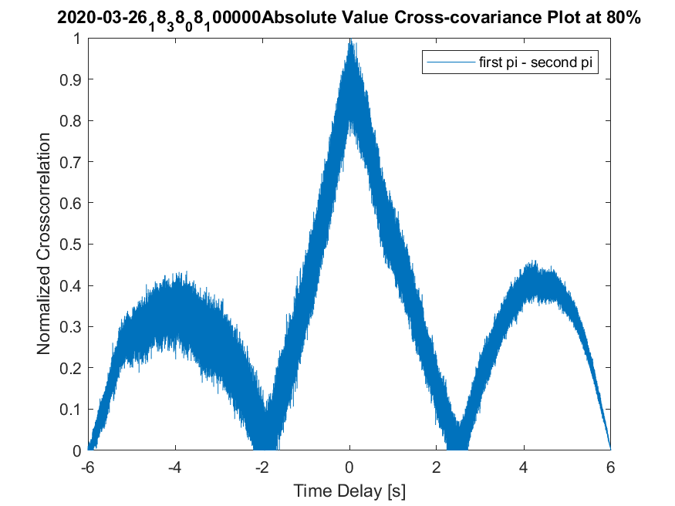
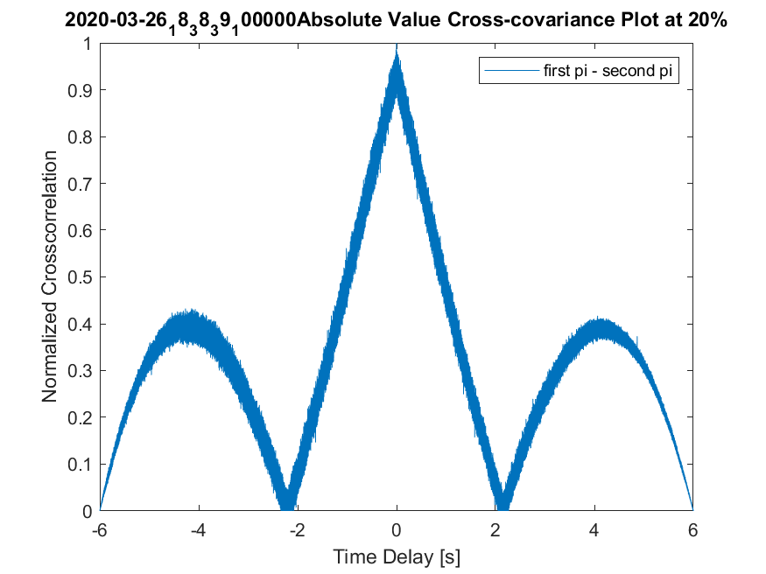
Results Using 6 second time intervals.
We switch to 6 second intervals. The best cross-correlations still maintain their shape, albeit more noisily. 80% represents the 24-30 second window of the recording. 20% the 6-12 second.

Slide 16
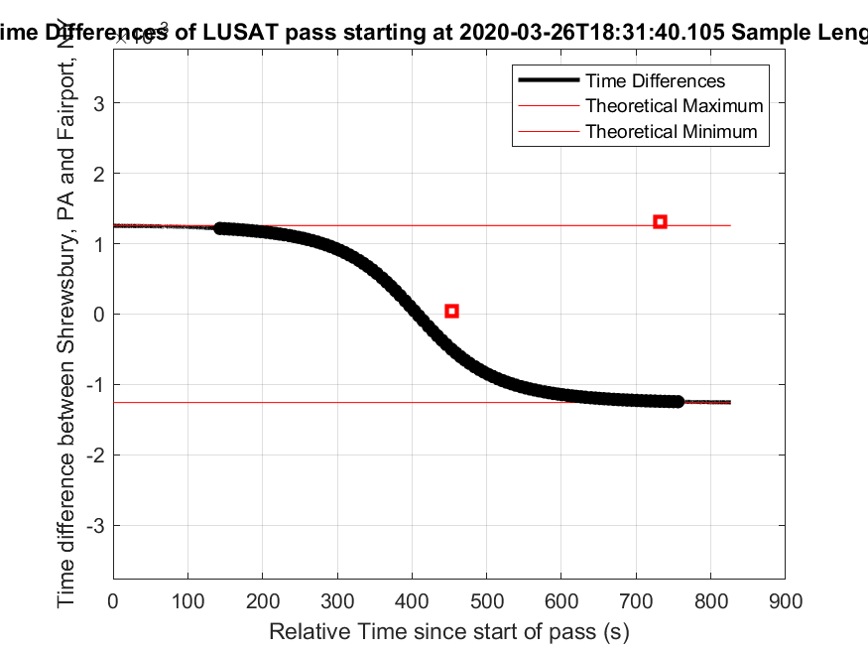
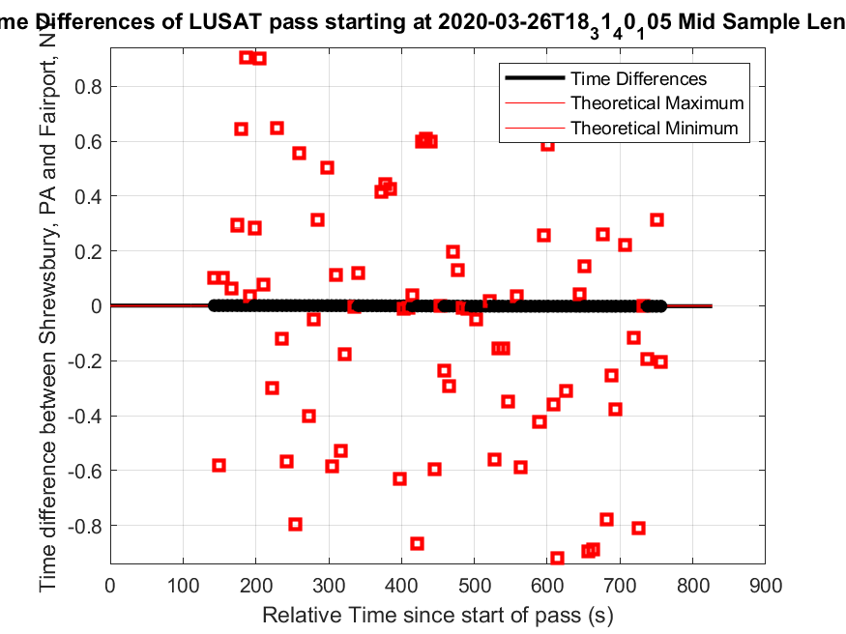
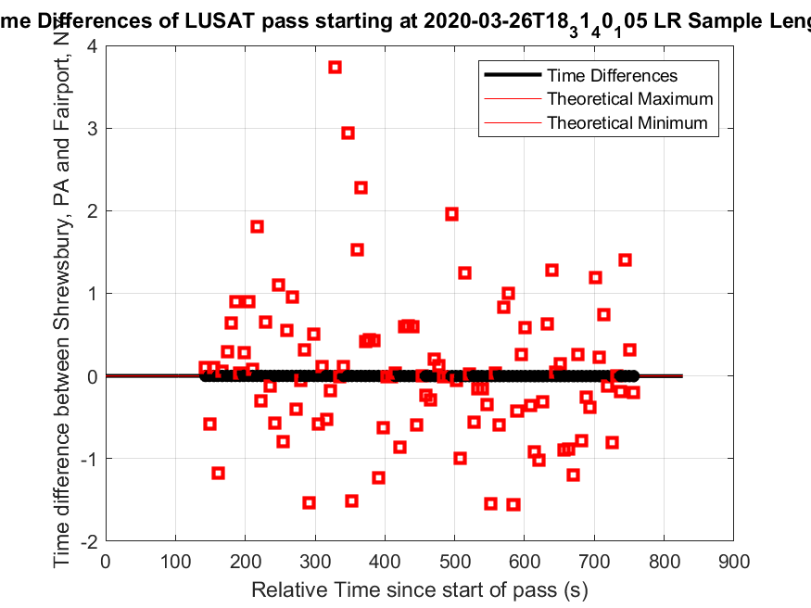
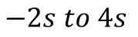
Results Using 6 second time intervals.
The below plots are all the same dataset, but have different y scales.
Only 2 of the time differences are remotely close to the correct answer!
The satellite moves ~48 km in a 6 second time interval with speeds of 8 km/s. It is understandable these are still wrong.
$$−4ms to 4ms$$
$$−0.9s to 0.9s$$
$$−2s to 4s$$

Slide 17
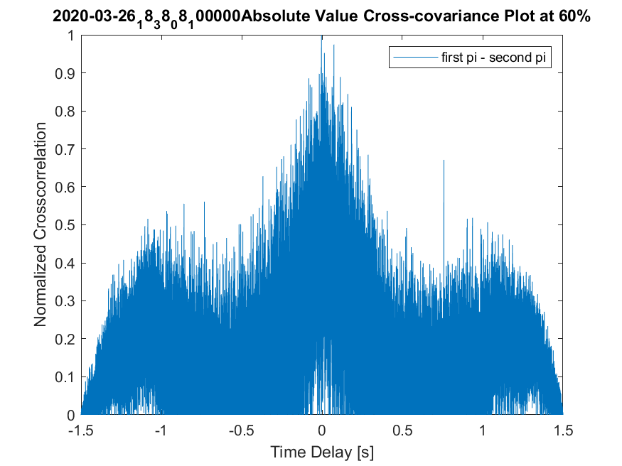
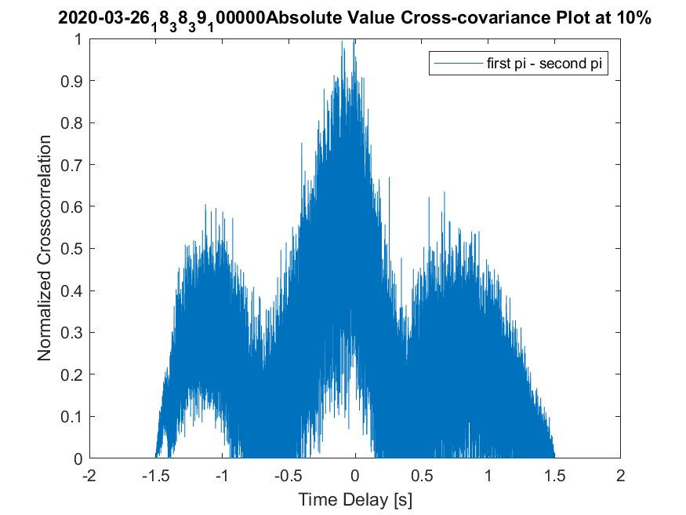
Results Using 1.5 second time intervals.
We switch to 1.5 second intervals. The best cross-correlations still maintain their shape, but are much noisier.

Slide 18
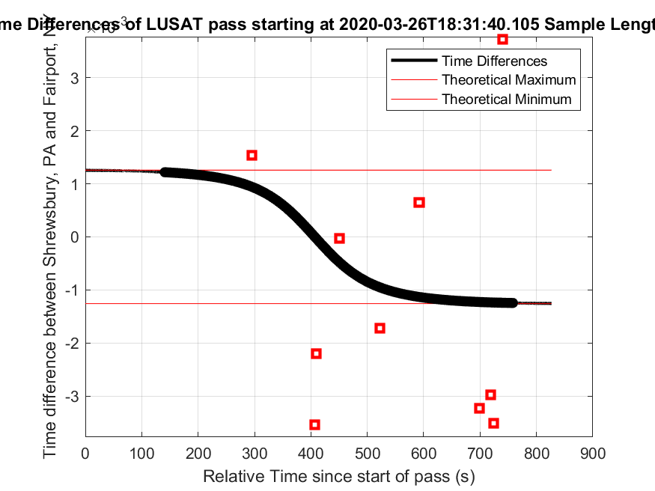
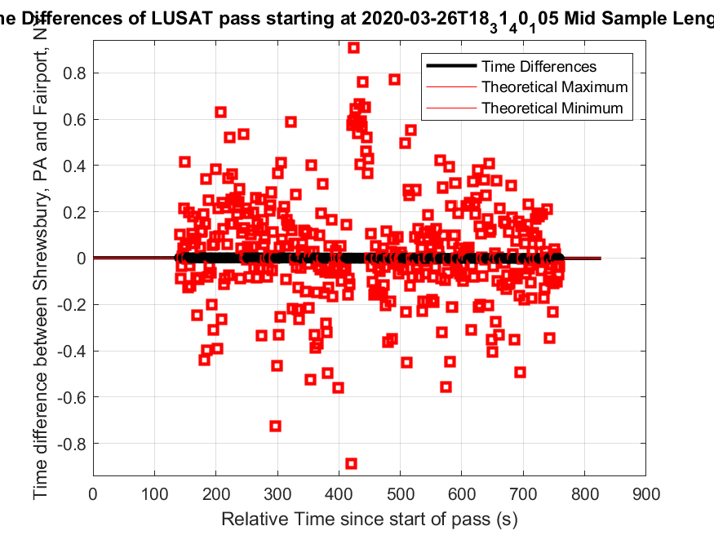
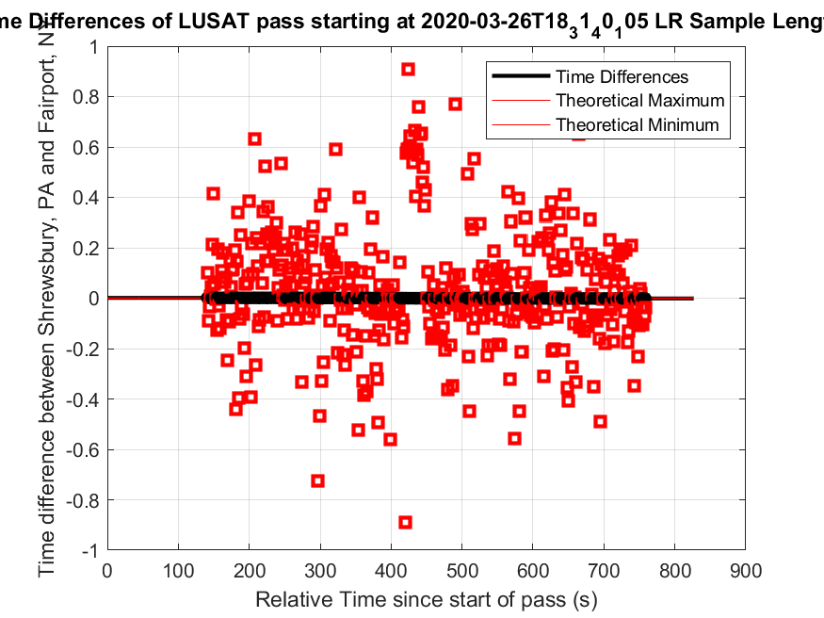
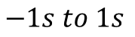
Results Using 1.5 second time intervals.
The below plots are all the same dataset, but have different y scales.
We now have 10 time differences in the vicinity of the correct answer, one especially close.
$$−4ms to 4ms$$
$$−0.9s to 0.9s$$
$$−1s to 1s$$

Slide 19
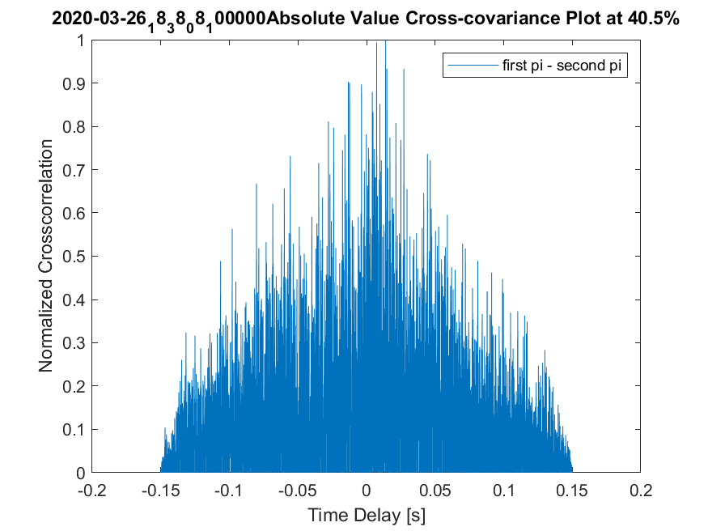
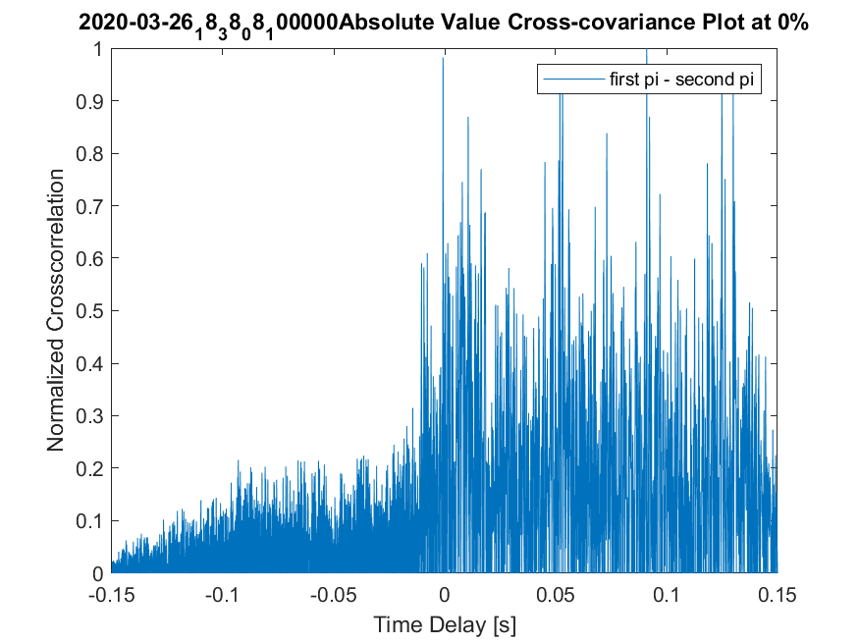
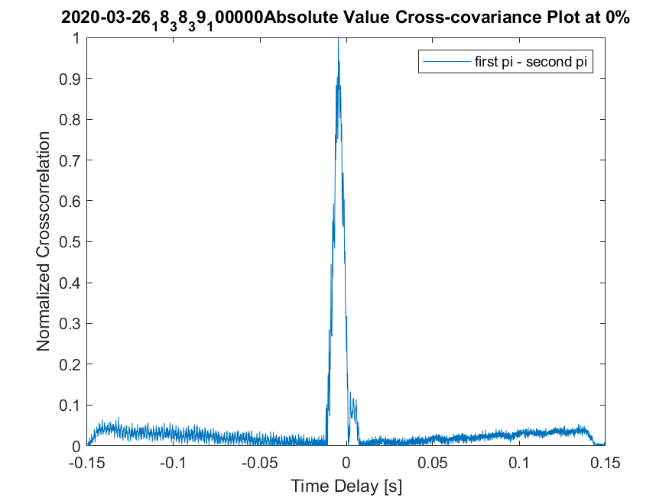
Results Using 0.15 second time intervals.
We switch to 0.15 second intervals. The output cross-correlation plots do not have their original shape. 99.5% of the plots look like the left and center plot. One plot out of the 200 looks like the right.
Left plot has okay accuracy. Center plot has large error.

Slide 20
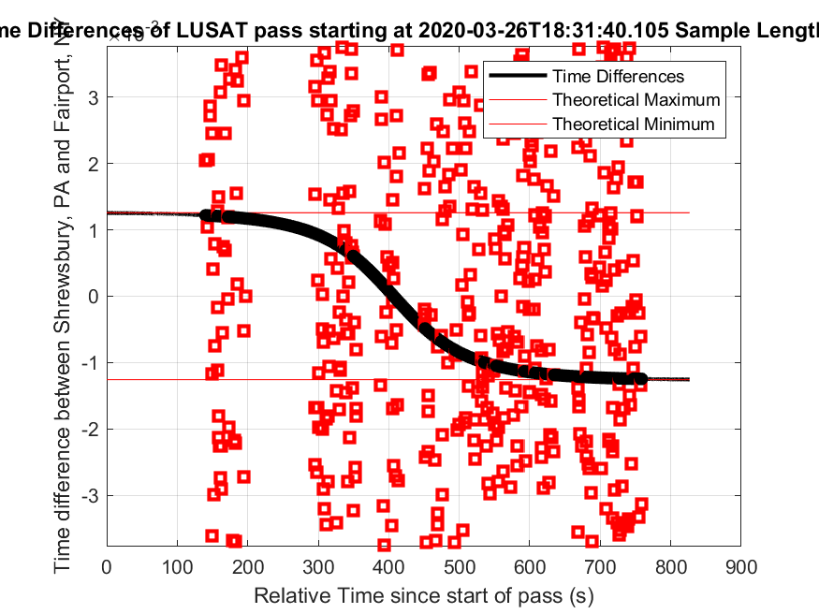
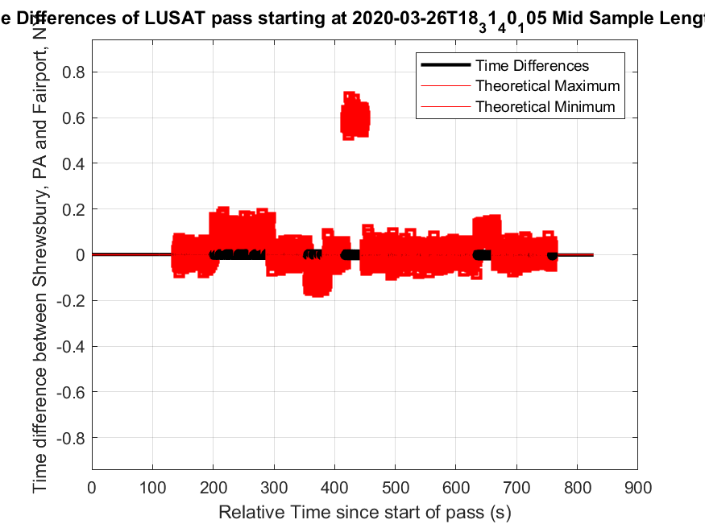
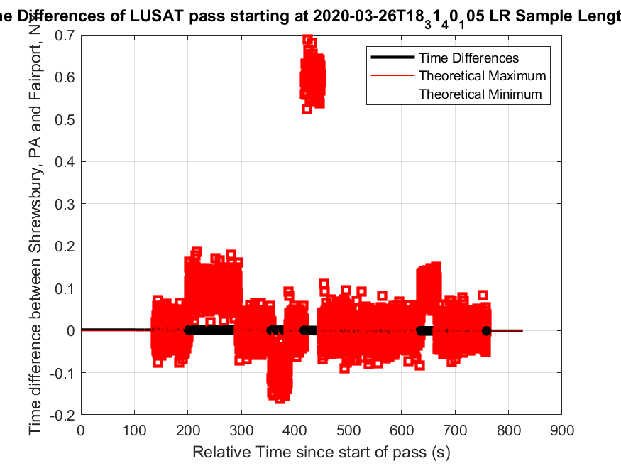
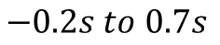
Results Using 0.15 second time intervals.
The below plots are all the same dataset, but have different y scales.
Several of the time differences end up near the correct answer.
More research is required to tell us if this is luck or if using this small of an interval is useful. The cross-correlation has lost all its shape, indicating its probably luck.
$$−4ms to 4ms$$
$$−0.9s to 0.9s$$
$$−0.2s to 0.7s$$

Slide 21
Compiled Results
Using smaller intervals is necessary to achieve better accuracy.
The optimal size of the interval is unknown.
Smaller intervals theoretically should yield better results based on approximating a continuous function with finer and finer deltas.
Bigger intervals yield better cross-correlation results.
Remember, the clocks were synced using the GPS, which measures to 100ms.
Some percentage of our error is due to clock inaccuracies. It is likely a big percentage of the error, based on what we saw in the reference tests in the lab.
Interval (s) | Root Mean Error (RMS): | Satellite est. distance traveled over interval | Quality of Cross-correlation
30 | 5.2448 | 240 km | High
6 | 1.2342 | 48 km | Medium
1.5 | 1.0108 | 12 km | Low
0.15 | 1.0010 | 1.2 km | Very Low

Slide 22
Key Takeaways
This was P20151’s most successful system level test
Multiple stations recording a satellite signal in remote locations at the same time
Strong satellite signals were received and documented
Meaningful conclusions can be drawn from the data
“Piggyback” method for predicting transmission is critical
Some satellites only operate as transponders, but we do not have Tx capability
Using another stations track record to predict satellite passes
The station we referenced had a 92% success rate with LUSAT
Notes:
Andrew

Slide 23
Next Steps
There is more to study in this dataset:
Consider limiting the max time difference
Consider secondary peaks instead of only taking the highest peak
Consider varying the interval length further
Consider using a different algorithm for demodulation (raw IQ data (complex), real part of IQ (real), WBFM (used, real), BPSK (?))
Consider capturing reference signal data in-between shorter satellite data captures

